Slide 1


Protection of tables at an overall level
What types of disclosures must be avoided
Statistical Disclosure Control (SDC) methods for protecting tables
SDC Course 2025
Øyvind Langsrud

Slide 2
Tabular data protection methods
Disclosure risk can be avoided by
using coarser categories
e.g. by counties instead of municipalities
by suppression (hiding values)
or by perturbation (changing values)

Slide 3
Contents
Types of Disclosures
Magnitude tables
Frequency tables
SDC Methods
Cell suppression
Perturbation
More details

Slide 4
Microdata
age | gender | income
young | male | 105
young | female | 102
young | female | 111
young | female | 115
middle | male | 108
middle | male | 121
middle | male | 166
middle | female | 144
middle | female | 273
old | male | 201
old | male | 251
old | male | 3435
A single person in each row
In other cases, a single company in each row
In general, a single statistical unit in each row

Slide 5
Microdata
Aggregated data
with a frequency variable
age | gender | income
young | male | 105
young | female | 102
young | female | 111
young | female | 115
middle | male | 108
middle | male | 121
middle | male | 166
middle | female | 144
middle | female | 273
old | male | 201
old | male | 251
old | male | 3435
age | gender | income | freq
young | female | 328 | 3
young | male | 105 | 1
middle | female | 417 | 2
middle | male | 395 | 3
old | male | 3887 | 3

Slide 6
Microdata
Aggregated data
with a frequency variable
and including a row of zeros
age | gender | income
young | male | 105
young | female | 102
young | female | 111
young | female | 115
middle | male | 108
middle | male | 121
middle | male | 166
middle | female | 144
middle | female | 273
old | male | 201
old | male | 251
old | male | 3435
age | gender | income | freq
young | female | 328 | 3
young | male | 105 | 1
middle | female | 417 | 2
middle | male | 395 | 3
old | female | 0 | 0
old | male | 3887 | 3

Slide 7
Frequency Table
age | gender | income | freq
young | female | 328 | 3
young | male | 105 | 1
middle | female | 417 | 2
middle | male | 395 | 3
old | female | 0 | 0
old | male | 3887 | 3
 | young | middle | old | Total
female | 3 | 2 | 0 | 5
male | 1 | 3 | 3 | 7
Total | 4 | 5 | 3 | 12
Now, another layout of the frequencies
With row and column totals
Each cell-value represents the number of statistical units

Slide 8
Magnitude Table
age | gender | income | freq
young | female | 328 | 3
young | male | 105 | 1
middle | female | 417 | 2
middle | male | 395 | 3
old | female | 0 | 0
old | male | 3887 | 3
 | young | middle | old | Total
female | 328 | 417 | 0 | 745
male | 105 | 395 | 3887 | 4387
Total | 433 | 812 | 3887 | 5132
Each cell value represents the sum of a continuous variable
Each statistical unit has contributed a value
which can be zero

Slide 9
Disclosure in a Magnitude Table
age | gender | income | freq
young | female | 328 | 3
young | male | 105 | 1
middle | female | 417 | 2
middle | male | 395 | 3
old | female | 0 | 0
old | male | 3887 | 3
 | young | middle | old | Total
female | 328 | 417 | 0 | 745
male | 105 | 395 | 3887 | 4387
Total | 433 | 812 | 3887 | 5132

Slide 10
Disclosure in a Magnitude Table
age | gender | income | freq
young | female | 328 | 3
young | male | 105 | 1
middle | female | 417 | 2
middle | male | 395 | 3
old | female | 0 | 0
old | male | 3887 | 3
 | young | middle | old | Total
female | 328 | 417 | 0 | 745
male | 105 | 395 | 3887 | 4387
Total | 433 | 812 | 3887 | 5132
This value can be used to estimate …
We will prevent the disclosure of a statistical unit's value
especially if the value is considered sensitive
It should also not be possible to estimate the value with high accuracy
The value of a single unit is disclosed

Slide 11
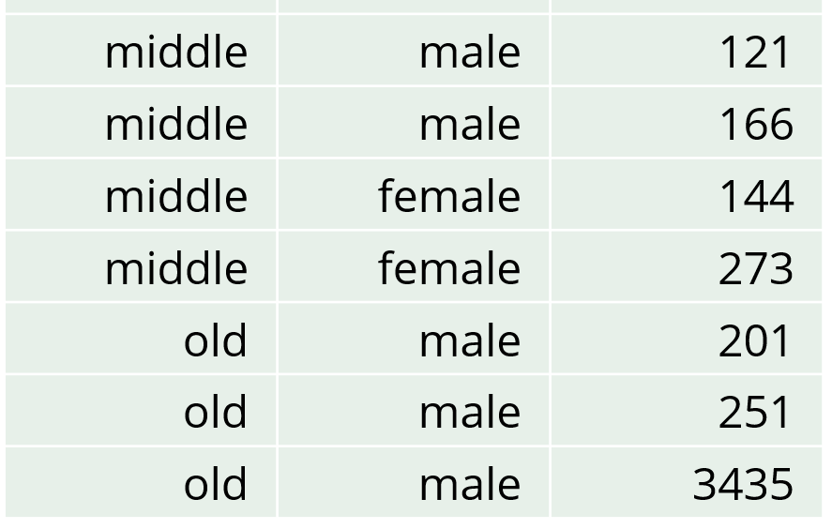
Estimate a value with high accuracy in a magnitude table
age | gender | income | freq
young | female | 328 | 3
young | male | 105 | 1
middle | female | 417 | 2
middle | male | 395 | 3
old | female | 0 | 0
old | male | 3887 | 3
 | young | middle | old | Total
female | 328 | 417 | 0 | 745
male | 105 | 395 | 3887 | 4387
Total | 433 | 812 | 3887 | 5132
This value can be used to estimate …
Suppose known that a person has a high income
The estimate, 3887, is only 13% higher than the person’s income
Acceptable?
The person with an income of 251 can subtract their own number
The estimate, 3887-251 = 3636, is only 5.8% higher than the person’s income
Acceptable?

Slide 12
Sensitive Cells in Magnitude Tables (cells that should be primary suppressed)
 | young | middle | old | Total
female | 328 | 417 | 0 | 745
male | 105 | 395 | 3887 | 4387
Total | 433 | 812 | 3887 | 5132
Cells with a single contribution
The value can be directly disclosed
Cells with two contributions
One contributor may disclose the value of the other contributor
Other cells according to rules
Either due to dominance rules, the p% rule or the few contributors rule.

Slide 13
Alternative rules
Cells with a single contribution
The value can be directly disclosed
Cells with two contributions
One contributor may disclose the value of the other contributor
Other cells according to rules
Either due to dominance rules, the p% rule or the few contributors rule.
With k₁ = 85 and k₂ = 95
Cell considered sensitive since
3435/3887 = 88.4% > k₁
With k₁ = 91 and k₂ = 92
Cell considered sensitive since
(3435+251)/3887 = 94.8% > k₂
Few contributors rule
Just a threshold for the number of contributors
Dominance rules
The largest contribution cannot exceed k₁% of the cell value
The sum of the 2 largest contributions cannot exceed k₂% of the cell value
p% rule
A rule targeting disclosure accuracy

Slide 14
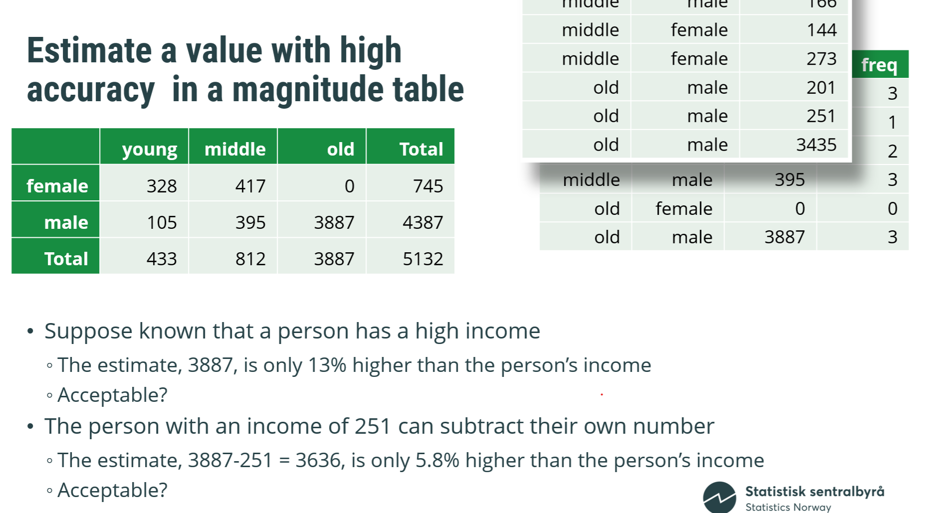
Alternative rules
Cells with a single contribution
The value can be directly disclosed
Cells with two contributions
One contributor may disclose the value of the other contributor
Other cells according to rules
Either due to dominance rules, the p% rule or the few contributors rule.
With rule p = 5
Cell not considered sensitive
With rule p = 6
Cell considered sensitive
Few contributors rule
Just a threshold for the number of contributors
Dominance rules
The largest contribution cannot exceed k₁% of the cell value
The sum of the 2 largest contributions cannot exceed k₂% of the cell value
p% rule
A rule targeting disclosure accuracy
A limit is set for this percentage value

Slide 15
Disclosure in a Frequency Table
 | young | middle | old | Total
female | 3 | 2 | 0 | 5
male | 1 | 3 | 3 | 7
Total | 4 | 5 | 3 | 12

Slide 16
Disclosure in a Frequency Table
 | young | middle | old | Total
female | 3 | 2 | 0 | 5
male | 1 | 3 | 3 | 7
Total | 4 | 5 | 3 | 12
The cell values themselves are not sensitive
All contributions are 1, and this is common knowledge
Disclosure concerns whether categories within a spanning variable can be disclosed
Sensitive variables
Given that categories within other spanning variables are already known
Identifying variables
Variables can be both sensitive and identifying

Slide 17
Disclosure in a Frequency Table
 | young | middle | old | Total
female | 3 | 2 | 0 | 5
male | 1 | 3 | 3 | 7
Total | 4 | 5 | 3 | 12
Gender sensitive and age identifying
Given age is old → The gender is male
Disclosure is possible due to a cell value of 0
The individual who is young and male knows that all other young individuals are female
Disclosure is possible due to a cell value of 1
Age sensitive and gender identifying
Given gender is female → Age is not old
Negative disclosure is possible due to a cell value of 0
The individual who is young and male knows that no other male individuals are young
Negative disclosure is possible due to a cell value of 1

Slide 18
Any Sensitive Cells in Frequency Tables?
 | young | middle | old | Total
female | 3 | 2 | 0 | 5
male | 1 | 3 | 3 | 7
Total | 4 | 5 | 3 | 12
The cell values themselves are not sensitive
To prevent disclosure, it is common practice to avoid small frequencies
Therefore, these cells are often labeled as sensitive
Consequently, zeros become sensitive

Slide 19
Small Counts considered as Sensitive Cells (cells that should be primary suppressed)
 | young | middle | old | Total
female | 3 | 2 | 0 | 5
male | 1 | 3 | 3 | 7
Total | 4 | 5 | 3 | 12
Cells with a frequency less than or equal to a certain threshold are considered sensitive
Choice of threshold:
0: Avoids the easiest form of disclosure
1: Prevents disclosure where a single unit could use information about itself
>1: Provides an even better safeguard against disclosure
This also prevents perceived disclosure, ensuring that individuals cannot identify themselves in the table.

Slide 20
Disclosure is possible – When sensitive cells are published
Avoiding disclosure risk
– Don’t publish sensitive cells
Sensitive cells:
Frequency tables: 0s, 1s, or small counts
Magnitude tables: few contributors or one/two dominant ones

Slide 21
Cell suppression

Slide 22
Cell suppression
Basic idea:
Identify cells in a table with high risk of disclosure (sensitive cells)
Prevent these from being published (primary suppression)
Suppress additional cells to ensure primary suppressed cells cannot be recalculated (secondary cell suppression)

Slide 23


simple method
optimal method
region | wages | pensions | assistance | other | Total
A | 11 | 36 | 55 | 11 | 113
B | 0 | 18 | 29 | 7 | 54
C | 8 | 25 | 35 | 5 | 73
D | 1 | 12 | 17 | 13 | 43
E | 14 | 52 | 63 | 9 | 138
F | 9 | 22 | 24 | 12 | 67
G | 4 | 8 | 22 | 6 | 40
H | 2 | 15 | 38 | 9 | 64
Total | 49 | 188 | 283 | 72 | 592
region | wages | pensions | assistance | other | Total
A | 11 | 36 | 55 | 11 | 113
B | 0 | 18 | 29 | 7 | 54
C | 8 | 25 | 35 | 5 | 73
D | 1 | 12 | 17 | 13 | 43
E | 14 | 52 | 63 | 9 | 138
F | 9 | 22 | 24 | 12 | 67
G | 4 | 8 | 22 | 6 | 40
H | 2 | 15 | 38 | 9 | 64
Total | 49 | 188 | 283 | 72 | 592
0
7
0
7
1
12
1
13
4
8
2
9
2
9

Slide 24
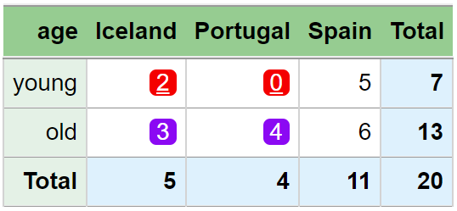
Another example
Two cells are secondary suppressed to avoid re-calculation from column totals.

Slide 25


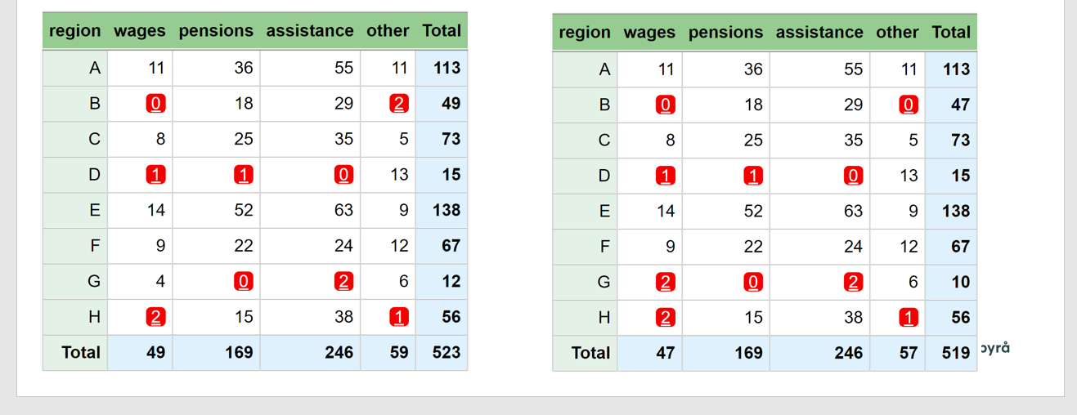
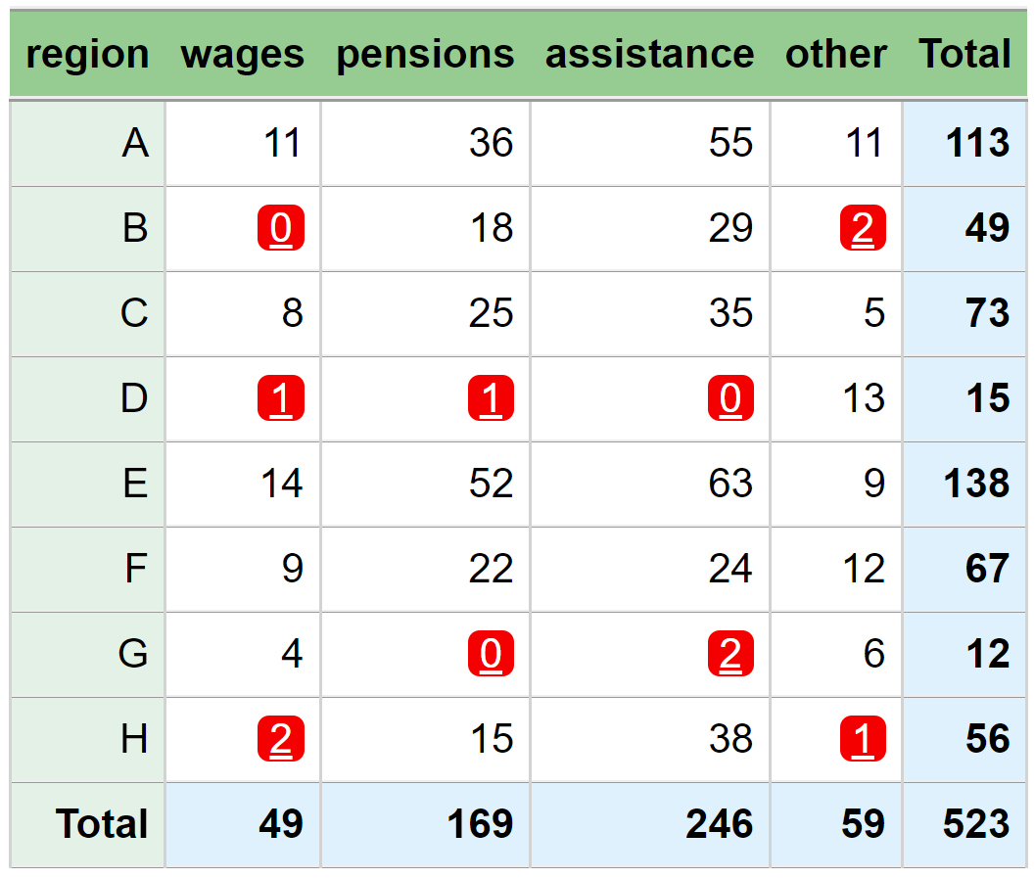
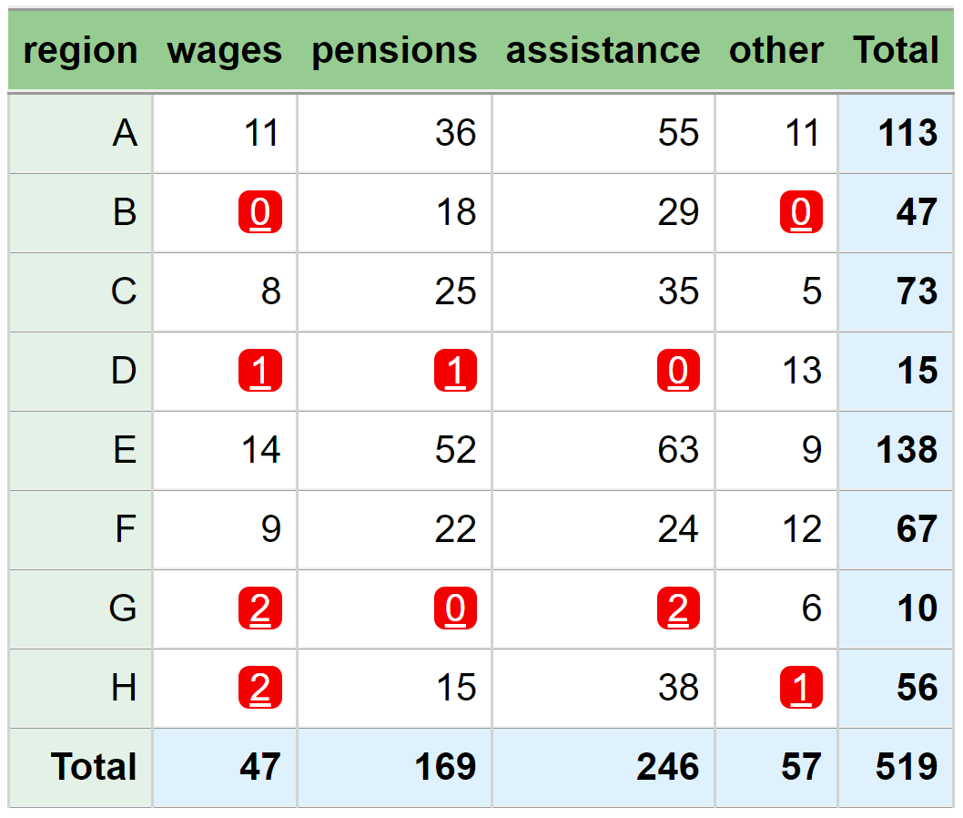


Secondary suppression is needed Do you see why?
When the sum of two frequencies is zero,
it is easy to conclude that both frequencies are zero
Therefore, secondary suppression is needed.
We can do calculations on sums of row B+H
B~H~other is calculated from the column sum
B~H~wages is calculated for the sum of row sums
D~wages can be easily calculated from the column sum
Therefore, secondary suppression is needed.
59-11-5-13-9-12-6 = 3
(49+56) - 3 - (29+38) - (15+18) = 2
49 - 2 -11-8-14-9-4 = 1

Slide 26
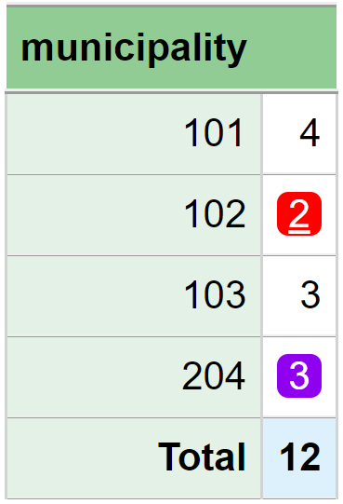
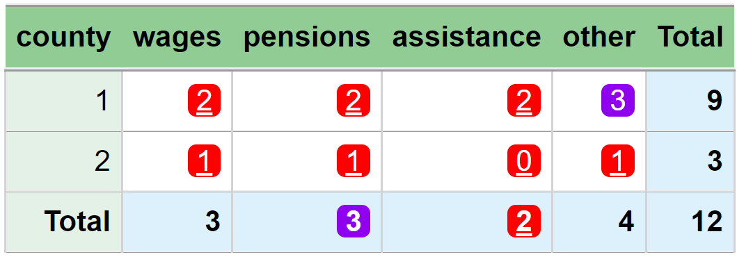
Tables should be coordinated
Microdata, 12 people
county municipality main_income
1 101 assistance
1 101 other
1 101 wages
1 101 wages
1 102 assistance
1 102 pensions
1 103 other
1 103 other
1 103 pensions
2 204 other
2 204 pensions
2 204 wages
Example: Two tables that are not coordinated
2 = 9 – 3 - 4
3 = 3
Calculation by using numbers in both tables
Since county~1 = municipality~101 + municipality~102 + municipality ~103
Suppressed in one table, but not the other.
Since county~2 = municipality~204

Slide 27


Secondary suppression algorithms
Standalone program supported by Eurostat
Several secondary suppression algorithms exist
The optimal algorithm is best
Implemented in Tau-Argus
Other algorithms are needed, as the optimal algorithm is only feasible for small datasets

Slide 28
Examples of secondary suppression algorithms
R-package
Modular algorithm (Tau-Argus)
SIMPLEHEURISTIC (sdcTable – quick and dirty)
GaussSuppression (Gaussian elimination algorithm)
GaussSuppression works well in practice
Additionally, Tau-Argus cannot be used in our new data platform
R-package

Slide 29
Tables should be coordinated
that are linked should be coordinated
How to handle linked tables?
This means that primary suppressions are adjusted based on secondary suppressions from other tables across iterations.
By iteration (a common method)
So that each table is safe
And so that common cells are suppressed equally
More advanced and better methods exist
In Tau-Argus
In the GaussSuppression R package

Slide 30
Perturbation
An alternative to suppression
Values are changed

Slide 31
Perturbation – two main approaches
All cells in the output are changed independently
+ Good control over the noise added to each cell
- Additive relationships are not preserved
• Cells based on the same contributors should be perturbed identically
The underlying microdata are changed
+ Additive relationships are preserved
+ Cells based on the same contributors are automatically perturbed identically
- Difficult to control the amount of noise added to each cell
• The disclosure risk relates to the published tables, not to the microdata
A common method is the
Cell Key Method
In other words, cells that aggregate the same underlying records

Slide 32
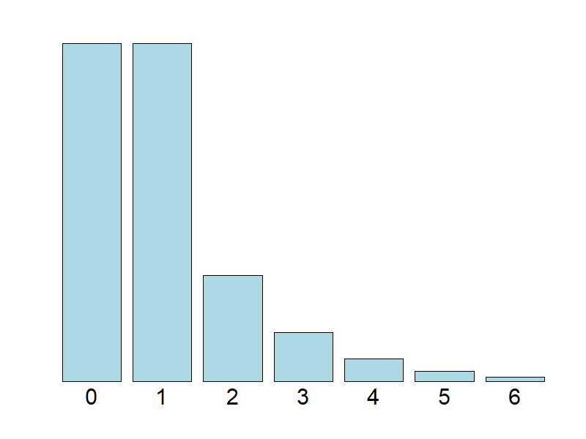
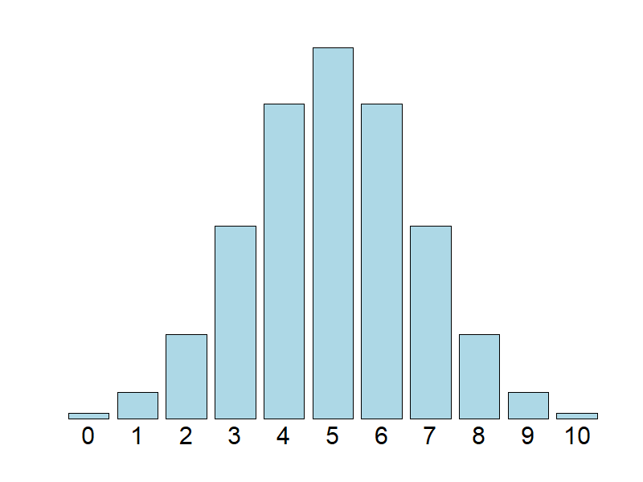
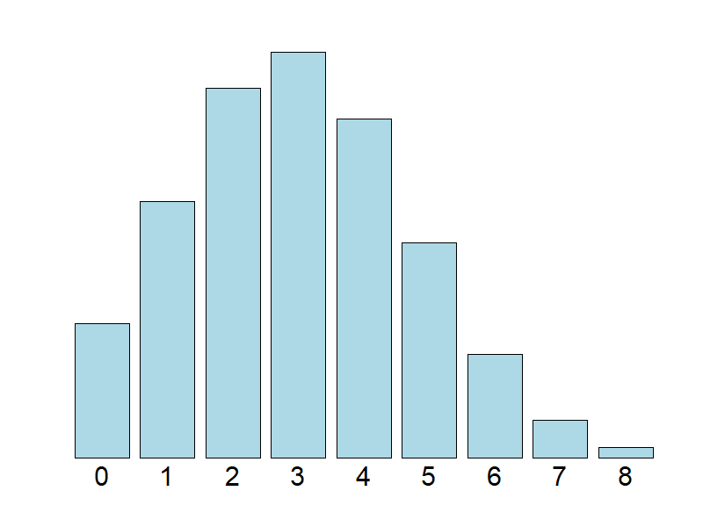
Cell Key Method – distributions
original count
= 1
The distributions are constructed so that the expected value is correct.
original count
= 5
original count
= 3

Slide 33
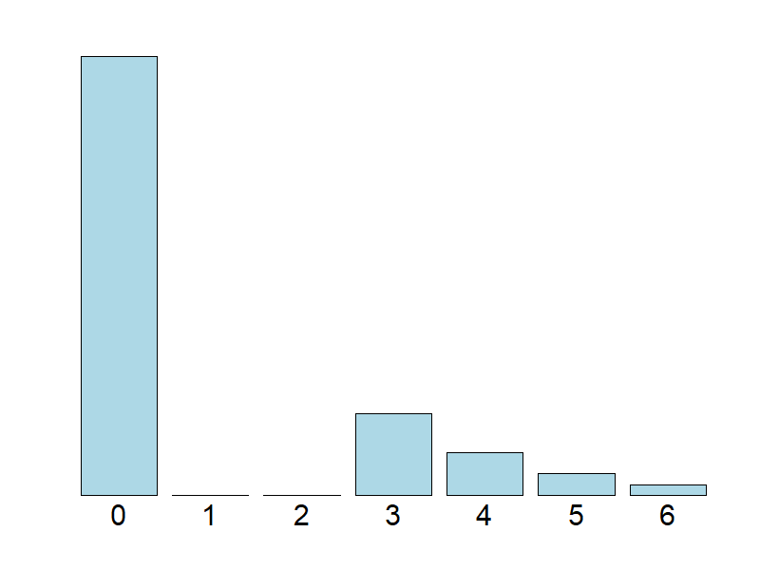
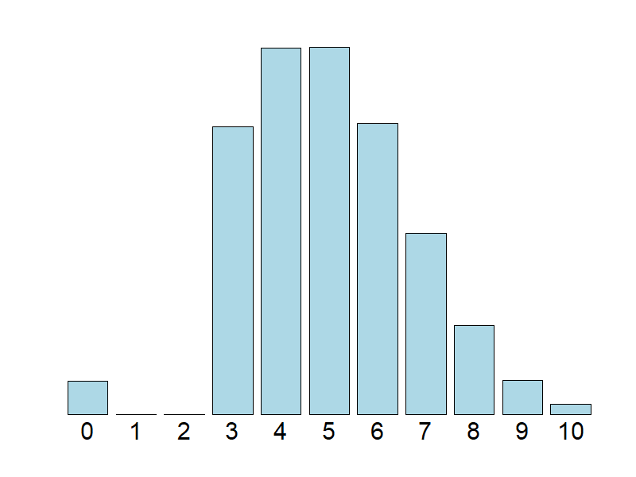
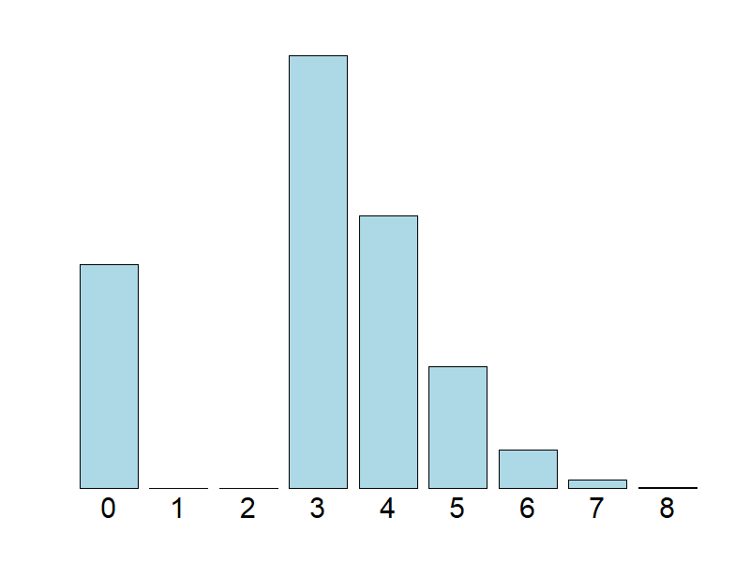
Cell Key Method – distributions
original count
= 1
preventing small frequencies
This is an option in the method.
original count
= 5
original count
= 3

Slide 34
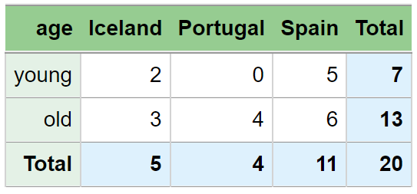
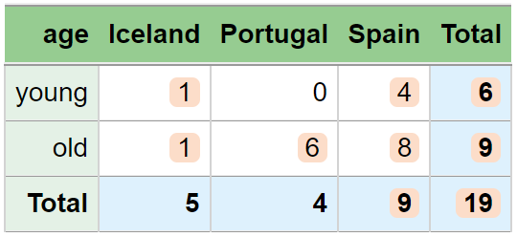
Cell Key example – without preventing small frequencies
Some cells keep their original value
Because of random variation
Small values (1s and 2s) are acceptable
Since they cannot be trusted as true values
But the standard method doesn’t perturb zeros
But you can’t know whether a 0 is real or not

Slide 35
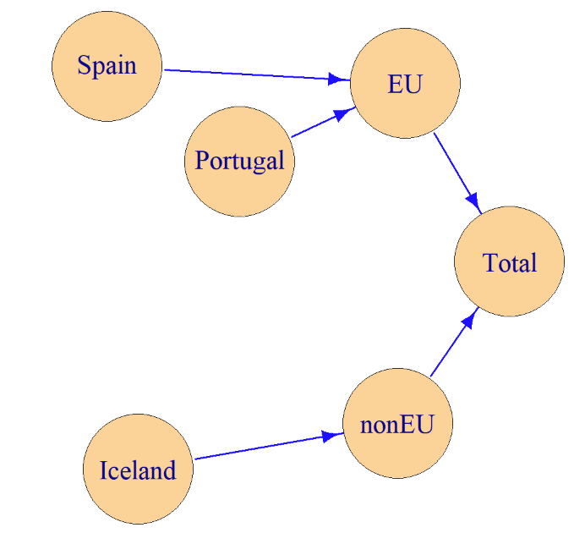
Cell Key example
We have hierarchically related variables

Slide 36
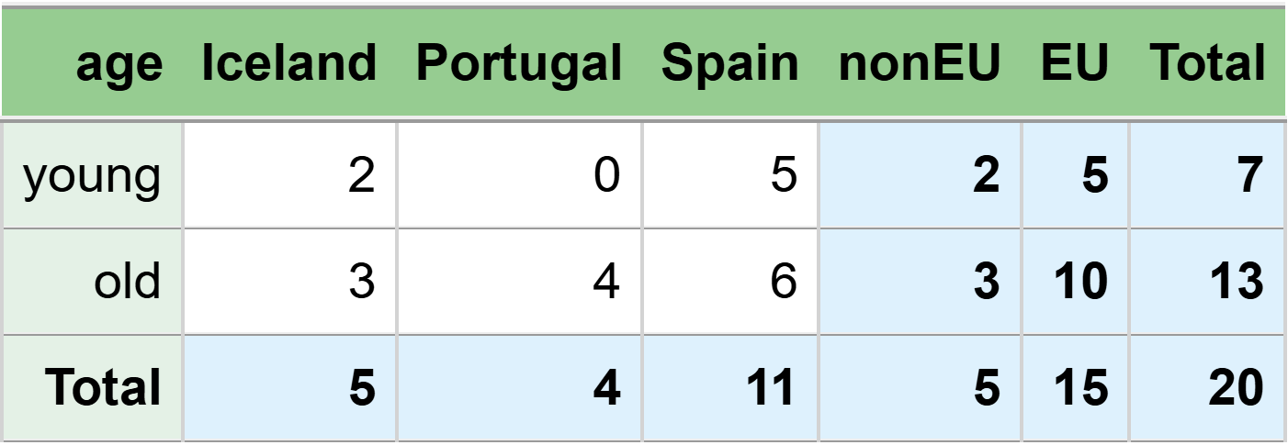
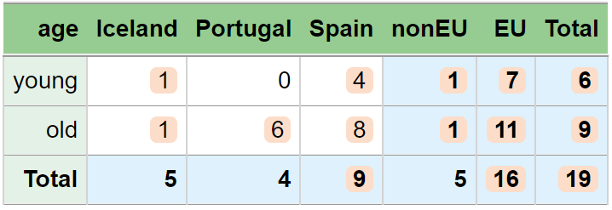
Cell Key example
The same perturbation for Iceland and nonEU, since the same underlying records.

Slide 37
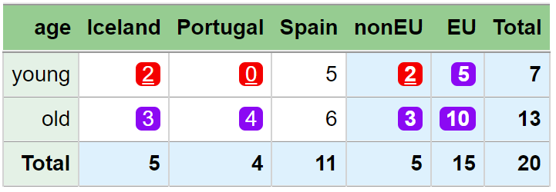
Suppression example

Slide 38
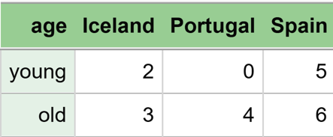
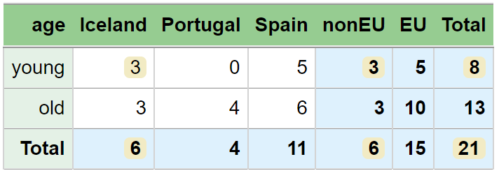
Small Count Rounding example

Slide 40
The Small Count Rounding Method
Some of the small counts (1s and 2s) in input data is rounded (to 0 or 3)
So that small counts in output is avoided
The algorithm tries to avoid big deviations from original values in the output data
microdata
age geo eu
1 young Spain EU
2 young Spain EU
3 young Spain EU
4 young Spain EU
5 young Spain EU
6 young Iceland nonEU
7 young Iceland nonEU
8 old Spain EU
9 old Spain EU
10 old Spain EU
11 old Spain EU
12 old Spain EU
13 old Spain EU
14 old Iceland nonEU
15 old Iceland nonEU
16 old Iceland nonEU
17 old Portugal EU
18 old Portugal EU
19 old Portugal EU
20 old Portugal EU
This input data is essentially the same as the microdata shown here.
input data
age geo eu freq
1 young Spain EU 5
2 young Iceland nonEU 2
3 young Portugal EU 0
4 old Spain EU 6
5 old Iceland nonEU 3
6 old Portugal EU 4

Slide 41
microdata
age geo eu
1 young Spain EU
2 young Spain EU
3 young Spain EU
4 young Spain EU
5 young Spain EU
6 young Iceland nonEU
7 young Iceland nonEU
8 old Spain EU
9 old Spain EU
10 old Spain EU
11 old Spain EU
12 old Spain EU
13 old Spain EU
14 old Iceland nonEU
15 old Iceland nonEU
16 old Iceland nonEU
17 old Portugal EU
18 old Portugal EU
19 old Portugal EU
20 old Portugal EU
The underlying microdata are changed
+ Additive relationships are preserved
+ Cells based on the same contributors are automatically perturbed identically
- Difficult to control the amount of noise added to each cell
• The disclosure risk relates to the published tables, not to the microdata
The Small Count Rounding Method
Can be viewed as a method that changes microdata
So one of the two main approaches shown earlier

Slide 42
Suppression
Perturbation
Small Count Rounding
Perturbation
Cell Key Method

Slide 43
Tabular data protection methods
Disclosure risk can be avoided by
using coarser categories
e.g. by counties instead of municipalities
by suppression (hiding values)
or by perturbation (changing values)
In addition to the methods we have discussed, tables can also be constructed in different ways.

Slide 44
More details

Slide 45
Corporate spending on employee gifts
Magnitude table example
 | Europe | America | Rest of World | Total world
Christmas gifts | 16.6 | 126.5 | 253.5 | 396.6
Other gifts | 35.9 | 84.5 | 9.2 | 129.6
Total gifts | 52.5 | 211.0 | 262.7 | 526.2
Why primary suppressions
126.5
253.5
84.5
9.2

Slide 46
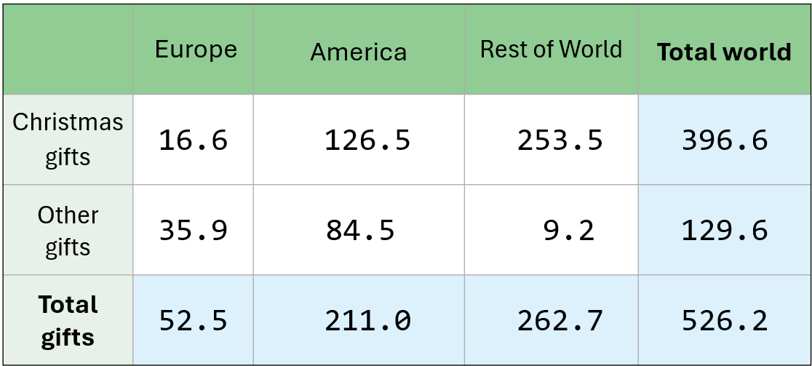
Corporate spending on employee gifts

Slide 47
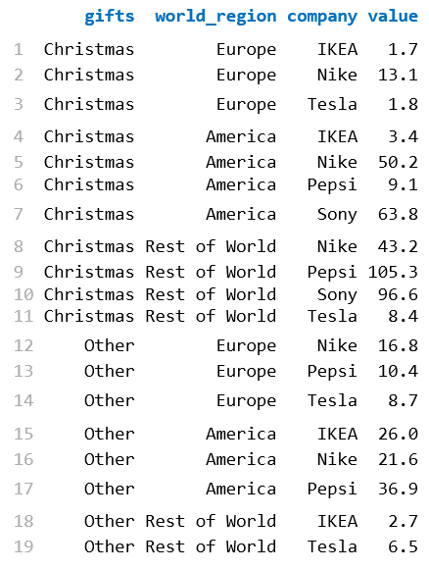
Underlying data
gifts world_region company value
1 Christmas Europe IKEA 1.7
2 Christmas Europe Nike 13.1
3 Christmas Europe Tesla 1.8
4 Christmas America IKEA 3.4
5 Christmas America Nike 50.2
6 Christmas America Pepsi 9.1
7 Christmas America Sony 63.8
8 Christmas Rest of World Nike 43.2
9 Christmas Rest of World Pepsi 105.3
10 Christmas Rest of World Sony 96.6
11 Christmas Rest of World Tesla 8.4
12 Other Europe Nike 16.8
13 Other Europe Pepsi 10.4
14 Other Europe Tesla 8.7
15 Other America IKEA 26.0
16 Other America Nike 21.6
17 Other America Pepsi 36.9
18 Other Rest of World IKEA 2.7
19 Other Rest of World Tesla 6.5

Slide 48
 | Europe | America | Rest of World | Total world
Christmas gifts | IKEA = 1.7 Nike = 13.1 Tesla = 1.8 k1 = 78.9%, k2 = 89.8% p = 13.0% | IKEA = 3.4 Nike = 50.2 Pepsi = 9.1 Sony = 63.8 k1 = 50.4%, k2 = 90.1% p = 19.6% | Nike = 43.2 Pepsi = 105.3 Sony = 96.6 Tesla = 8.4 k1 = 41.5%, k2 = 79.6% p = 49.0% | IKEA = 5.1 Nike = 106.5 Pepsi = 114.4 Sony = 160.4 Tesla = 10.2 k1 = 40.4%, k2 = 69.3% p = 75.9%
Other gifts | Nike = 16.8 Pepsi = 10.4 Tesla = 8.7 k1 = 46.8%, k2 = 75.8% p = 51.8% | IKEA = 26.0 Nike = 21.6 Pepsi = 36.9 k1 = 43.7%, k2 = 74.4% p = 58.5% | IKEA = 2.7 Tesla = 6.5 k1 = 70.7%, k2 = 100.0% p = 0.0% | IKEA = 28.7 Nike = 38.4 Pepsi = 47.3 Tesla = 15.2 k1 = 36.5%, k2 = 66.1% p = 92.8%
Total gifts | IKEA = 1.7 Nike = 29.9 Pepsi = 10.4 Tesla = 10.5 k1 = 57.0%, k2 = 77.0% p = 40.5% | IKEA = 29.4 Nike = 71.8 Pepsi = 46.0 Sony = 63.8 k1 = 34.0%, k2 = 64.3% p = 105.0% | IKEA = 2.7 Nike = 43.2 Pepsi = 105.3 Sony = 96.6 Tesla = 14.9 k1 = 40.1%, k2 = 76.9% p = 57.7% | IKEA = 33.8 Nike = 144.9 Pepsi = 161.7 Sony = 160.4 Tesla = 25.4 k1 = 30.7%, k2 = 61.2% p = 126.2%
k1 = 13.1/16.6 = 78.9%
k2 = (13.1+1.8)/16.6 = 89.7%
p = (16.6 - 1.8 - 13.1) / 13.1 = 13.0 %
Different notation. Now k1, k1 and p are not the rule-values, but observed values in the data.

Slide 49
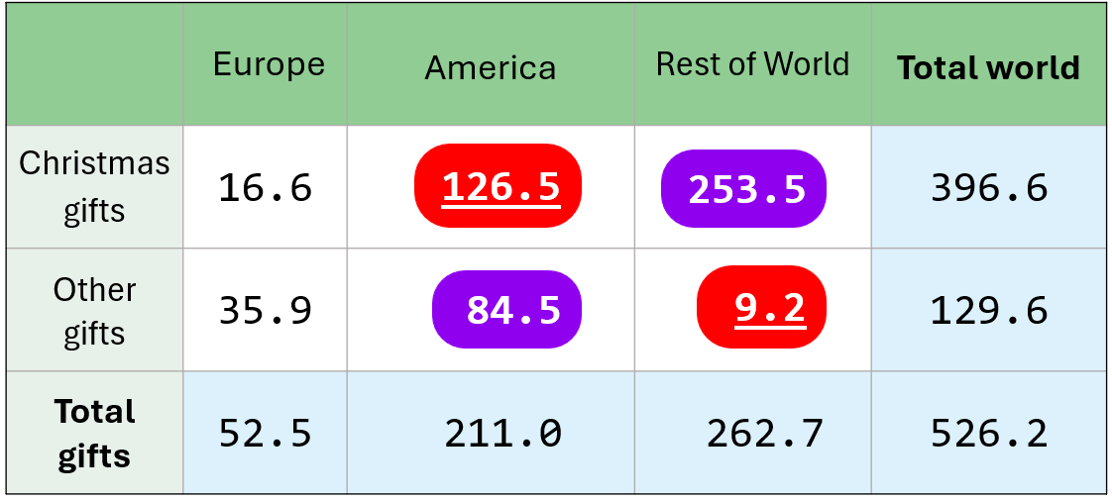
 | Europe | America | Rest of World | Total world
Christmas gifts | IKEA = 1.7 Nike = 13.1 Tesla = 1.8 k1 = 78.9%, k2 = 89.8% p = 13.0% | IKEA = 3.4 Nike = 50.2 Pepsi = 9.1 Sony = 63.8 k1 = 50.4%, k2 = 90.1% p = 19.6% | Nike = 43.2 Pepsi = 105.3 Sony = 96.6 Tesla = 8.4 k1 = 41.5%, k2 = 79.6% p = 49.0% | IKEA = 5.1 Nike = 106.5 Pepsi = 114.4 Sony = 160.4 Tesla = 10.2 k1 = 40.4%, k2 = 69.3% p = 75.9%
Other gifts | Nike = 16.8 Pepsi = 10.4 Tesla = 8.7 k1 = 46.8%, k2 = 75.8% p = 51.8% | IKEA = 26.0 Nike = 21.6 Pepsi = 36.9 k1 = 43.7%, k2 = 74.4% p = 58.5% | IKEA = 2.7 Tesla = 6.5 k1 = 70.7%, k2 = 100.0% p = 0.0% | IKEA = 28.7 Nike = 38.4 Pepsi = 47.3 Tesla = 15.2 k1 = 36.5%, k2 = 66.1% p = 92.8%
Total gifts | IKEA = 1.7 Nike = 29.9 Pepsi = 10.4 Tesla = 10.5 k1 = 57.0%, k2 = 77.0% p = 40.5% | IKEA = 29.4 Nike = 71.8 Pepsi = 46.0 Sony = 63.8 k1 = 34.0%, k2 = 64.3% p = 105.0% | IKEA = 2.7 Nike = 43.2 Pepsi = 105.3 Sony = 96.6 Tesla = 14.9 k1 = 40.1%, k2 = 76.9% p = 57.7% | IKEA = 33.8 Nike = 144.9 Pepsi = 161.7 Sony = 160.4 Tesla = 25.4 k1 = 30.7%, k2 = 61.2% p = 126.2%
With 90% as k2-limit. This cell is primary suppressed.
With 15% as p%-limit. This cell is primary suppressed instead.

Slide 50
Perturbation of magnitude tables
not as common

Slide 51
The EZS-method (Evans, Zayatz and Slanta, 1998)
Noise is added at the microdata
Each contributor is assigned direction +1 or -1 and a noise factor
𝑝𝑒𝑟𝑡𝑢𝑟𝑏𝑒𝑑 𝑣𝑎𝑙𝑢𝑒 = 𝑜𝑟𝑖𝑔𝑖𝑛𝑎𝑙 𝑣𝑎𝑙𝑢𝑒 ∗ (1 + 𝑑𝑖𝑟𝑒𝑐𝑡𝑖𝑜𝑛 ∗ 𝑛𝑜𝑖𝑠𝑒 𝑓𝑎𝑐𝑡𝑜𝑟/100)
Thereafter a special balancing procedure for the 𝑑𝑖𝑟𝑒𝑐𝑡𝑖𝑜𝑛 component
less noise to non-sensitive cells
more noise to sensitive cells
See
Sabolová, Tepe, Adriansson and Almberg (2025)
Using perturbative methods for magnitude tables in Statistical disclosure Control,
Expert Meeting on Statistical Data Confidentiality, 15 - 17 October 2025, Barcelona Spain.
Sensitive cells similar to primary suppression

Slide 52
Cell Key Method for magnitude tables
Implemented i the cellKey R package
Along with the more common frequency table method

Slide 53
Intervals

Slide 54
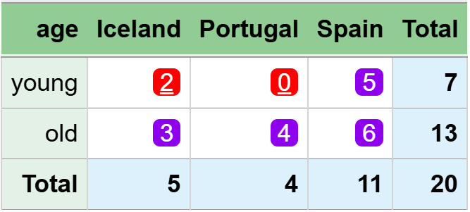
The two young individuals from Iceland, as a group, can disclose that all other young individuals are from Spain.
This is also the case after suppression.
Primary cells are protected
In the sense that their exact values cannot be recalculated
But intervals can still be derived
In this example, both primary cells end up with the interval:
[0, 2]
Is that acceptable?
No, not when you consider the rationale behind the primary suppression.
A solution is to set requirements for the intervals
It can be done in Tau-Argus and GaussSuppression

Slide 55
In this case, one would say that the intervals are ok.
[0.0, 93.7]
[117.3, 211.0]

Slide 56
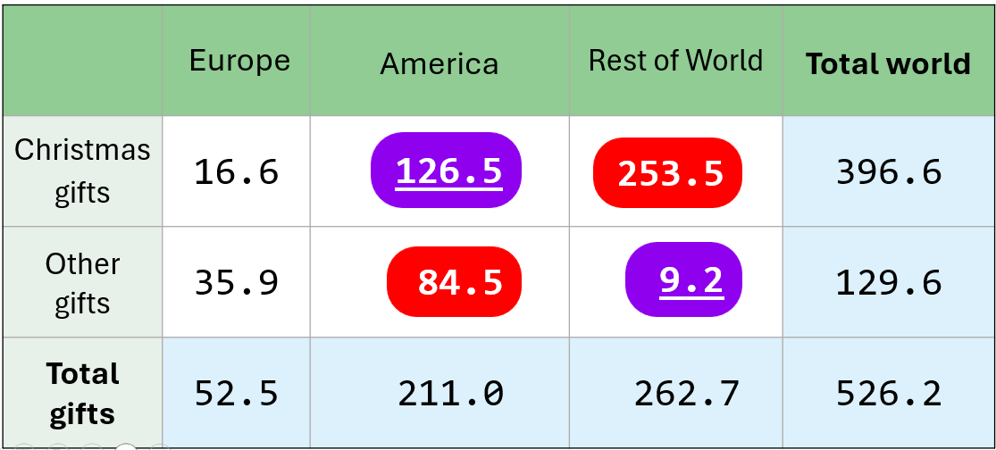
But assume the opposite primary suppression
An assume a single contributor behind 84.5.
Then the true value is 90.2% of the upper interval limit.
→ NOT OK
[0.0, 93.7]
[169.0, 262.7]
When the k1-limit is 90% or less.

Slide 57
Intervals
[0, 2]
[117.3, 211.0]
[169.0, 262.7]
[0.0, 93.7]
[0.0, 93.7]
For the tables to be properly protected,
interval protection is needed.
But this requires heavy computations for large tables,
and it is quite common not to apply it in practice.

Slide 58
Difference cells

Slide 59
Input data
age age3 age5 count
0 0_2 [0,4] 5
1 0_2 [0,4] 7
2 0_2 [0,4] 3
3 3_5 [0,4] 0
4 3_5 [0,4] 1
5 3_5 [5,9] 2
6 6_8 [5,9] 5
7 6_8 [5,9] 4
8 6_8 [5,9] 6
9 9_11 [5,9] 0
10 9_11 [10,14] 8
11 9_11 [10,14] 4
12 12_14 [10,14] 9
13 12_14 [10,14] 3
14 12_14 [10,14] 7
Published data
age count
Total 64
0_2 15
3_5 3
6_8 15
9_11 12
12_14 19
[0,4] 16
[5,9] 17
[10,14] 31

Slide 60
Input data
age age3 age5 count
0 0_2 [0,4] 5
1 0_2 [0,4] 7
2 0_2 [0,4] 3
3 3_5 [0,4] 0
4 3_5 [0,4] 1
5 3_5 [5,9] 2
6 6_8 [5,9] 5
7 6_8 [5,9] 4
8 6_8 [5,9] 6
9 9_11 [5,9] 0
10 9_11 [10,14] 8
11 9_11 [10,14] 4
12 12_14 [10,14] 9
13 12_14 [10,14] 3
14 12_14 [10,14] 7
Sum of age = 3 and age = 4?
= [0,4] - 0_2
= 16 -15 = 1
Published data
age count
Total 64
0_2 15
3_5 3
6_8 15
9_11 12
12_14 19
[0,4] 16
[5,9] 17
[10,14] 31
Sum of age = 5 and age = 9?
= [5,9] - 6_8
= 17 -15 = 2

Slide 61
Input data
age age3 age5 count
0 0_2 [0,4] 5
1 0_2 [0,4] 7
2 0_2 [0,4] 3
3 3_5 [0,4] 0
4 3_5 [0,4] 1
5 3_5 [5,9] 2
6 6_8 [5,9] 5
7 6_8 [5,9] 4
8 6_8 [5,9] 6
9 9_11 [5,9] 0
10 9_11 [10,14] 8
11 9_11 [10,14] 4
12 12_14 [10,14] 9
13 12_14 [10,14] 3
14 12_14 [10,14] 7
Count for age = 9?
= 9_11 + 12_14 - [10,14]
= 12 + 19 - 31 = 0
or
= [0,4] + [5,9] - 0_2 - 3_5 - 6_8
= 16 + 17 – 15 – 3 - 15 = 0
Published data
age count
Total 64
0_2 15
3_5 3
6_8 15
9_11 12
12_14 19
[0,4] 16
[5,9] 17
[10,14] 31

Slide 62
Input data
age age3 age5 count
0 0_2 [0,4] 5
1 0_2 [0,4] 7
2 0_2 [0,4] 3
3 3_5 [0,4] 0
4 3_5 [0,4] 1
5 3_5 [5,9] 2
6 6_8 [5,9] 5
7 6_8 [5,9] 4
8 6_8 [5,9] 6
9 9_11 [5,9] 0
10 9_11 [10,14] 8
11 9_11 [10,14] 4
12 12_14 [10,14] 9
13 12_14 [10,14] 3
14 12_14 [10,14] 7
Count for age = 5?
= 0_2 + 3_5 - [0,4]
= 15 + 3 - 16 = 2
or
= [5,9] + [10,14] - 6_8 - 9_11 - 12_14
= 17 + 31 -15 -12 – 19 = 2
Published data
age count
Total 64
0_2 15
3_5 3
6_8 15
9_11 12
12_14 19
[0,4] 16
[5,9] 17
[10,14] 31

Slide 63
Difference cells
[5,9] - 6_8
9_11 + 12_14 - [10,14]
[0,4] + [5,9] - 0_2 - 3_5 - 6_8
[0,4] - 0_2
Finding and protecting all sensitive cells in the published tables is not always sufficient
Difference cells can be derived, and some of them may themselves be sensitive
We have seen this in frequency tables, and the same issue arises in magnitude tables

Slide 64
Difference cells
[5,9] - 6_8
9_11 + 12_14 - [10,14]
[0,4] + [5,9] - 0_2 - 3_5 - 6_8
[0,4] - 0_2
Particularly challenging when using suppression
Also important to consider when applying perturbation methods

Slide 65
Takk!

